Slide 1
National Academic Depository (NAD) NDML Welcomes Academic Institutions
December 15th , 2017

Slide 2
Academic Institutions Participating in NDML NAD
Central Universities (27)
State Universities (28)
Private Universities (11)
Deemed to be Universities (15)
Institutions of National Importance – INI (10)
Institutions Under Ministries & Other Higher Education Institutes (3)
School & Technical Boards (10)
Region & State Wise List

Slide 3
Central Universities
North
Delhi | Jamia Millia Islamia, New Delhi
Haryana | Central University Of Haryana, Pali
Jammu & Kashmir | Central University Of Jammu, Jammu
 | Central University Of Kashmir, Srinagar
Uttar Pradesh | Babasaheb Bhimrao Ambedkar University
East
Arunachal | Rajiv Gandhi University, Itanagar
Assam | Assam University, Silchar Tezpur Universty, Tezpur
Bihar | Central University Of South Bihar, Patna Mahatma Gandhi Central University
Chhattisgarh | Guru Ghasidas Vishwavidyalaya, Bilaspur
Jharkhand | Central University Of Jharkhand, Ranchi
Manipur | Manipur University, Imphal
Meghalaya | North Eastern Hill University, Shillong
Mizoram | Mizoram University, Aizawl
Odisha | Central University Of Orissa, Koraput
Tripura | Tripura University, Agartala
West Bengal | Visva-Bharati, Bolpur
South
Andhra | University Of Hyderabad, Hyderabad
Karnataka | Central University Of Karnataka, Kadaganchi
Puducherry | Pondicherry Univeristy, Puducherry
Tamil Nadu | Central University Of Tamilnadu, Thiruvarur
Telangana | The English And Foreign Languages University
West
Gujarat | Central University Of Gujarat, Gandhinagar
Madhya Pradesh | Dr. Harisingh Gour University, Sagar
Maharashtra | Mahatma Gandhi Antarrashtriya Hindi Vishwavidyalaya, Wardha

Slide 4
State Universities
North
Himachal Pradesh | Dr. Yashwant Singh Parmar University Of Horticulture & Forestry, Solan Himachal Pradesh Technical University, Hamirpur
Uttar Pradesh | Chhatrapati Shahuji Maharaj University, Kanpur Sharda University, Noida
East
Assam | Assam Agricultural University, Jorhat
Chhattisgarh | Indira Gandhi Krishi Vishwavidyalaya, Raipur Pt. Ravishankar Shukla University, Raipur
Jharkhand | Sido Kanhu Murmu University, Dighi
Odisha | National Law University Odisha, Cuttack
West Bengal | Vidyasagar University, Midnapore
West
Gujarat | Indian Institute Of Teacher Education,
Maharashtra | North Maharashtra University, Jalgaon Rashtrasant Tukadoji Maharaj Nagpur University, Nagpur University Of Mumbai, Mumbai Yashwantrao Chavan Maharashtra Open University, Nasik
Rajasthan | Jai Narain Vyas University, Jodhpur Mohanlal Sukhadia University, Udaipur University Of Rajasthan, Jaipur Maharshi Dayanand Saraswati University, Ajmer
South
Tamil Nadu | Alagappa University, Karaikudi Annamalai University, Karaikudi Tamil Nadu Open University, Chennai Tamil Nadu Teacher Education University, Chennai
Andhra Pradesh | Mahatma Gandhi University, Nalgonda Rayalaseema University, Kurnool Sri Padmavathi Mahila Visva Vidyalayam, Tirupati Sri Venkateswara University, Tirupati Sri Venkateswara Vetenary University, Tirupati

Slide 5
Private Universities
Delhi | Indraprastha Institute Of Information Technology, Delhi
Gujarat | Charotar University Of Science & Technology, Anand Raksha Shakti University, Ahmedabad
Himachal Pradesh | Chitkara University Himachal, Baddi Jaypee University Of Information Technology, Solan
Madhya Pradesh | Amity University Of Madhya Pradesh, Gwalior Peoples University, Bhopal
Odisha | Birla Global University, Bhubaneshwar
Rajasthan | Singhania University, Jhunjhunu University Of Engineering & Management, Jaipur
Sikkim | Sikkim Manipal University, Gangtok

Slide 6
Deemed to be Universities
Andhra Pradesh | Rastriya Sanskrit Vidyapeeth, Tirupati
Delhi | Indian Agricultural Research Institute, Delhi Indian Law Institute, Delhi Jamia Hamdard University, Delhi Teri University, Delhi
Kerala | Indian Institute Of Space Science And Technology, Thiruvananthapuram
Maharashtra | MGM Institute of Health Sciences, Navi Mumbai Narsee Monjee Institute Of Management Studies, Mumbai
Tamilnadu | Bharath Institute Of Higher Education & Research, Chennai Hindustan Institute Of Technology And Science, Kancheepuram Meenakshi Academy Of Higher Education And Research, Chennai Noorul Islam Centre For Higher Education, Nagercoil Sathyabama Institute Of Science & Technology, Chennai The Gandhigram Rural Institute, Chinnalapatti
Uttarpradesh | Central Deemed University Of Tibetan Studies, Varanasi

Slide 7
Institutions of National Importance & Other Institutions under Ministries
Delhi | NIT, Delhi School of Planning & Architecture, Delhi
Jharkhand | NIT, Jamshedpur
Karnataka | NIT, Surathkal, Mangaluru
Madhya Pradesh | IIT, Indore IIM, Indore
Maharashtra | Shree Chanakya Education Society's Indira Institute of Management, Pune Film & Television Institute Of India, Pune
Puducherry | NIT, Puducherry
Punjab | IISER, Mohali
West Bengal | IISER, Kolkatta NIT, Durgapur Satyajit Ray Film and Television Institute, Kolkata

Slide 8
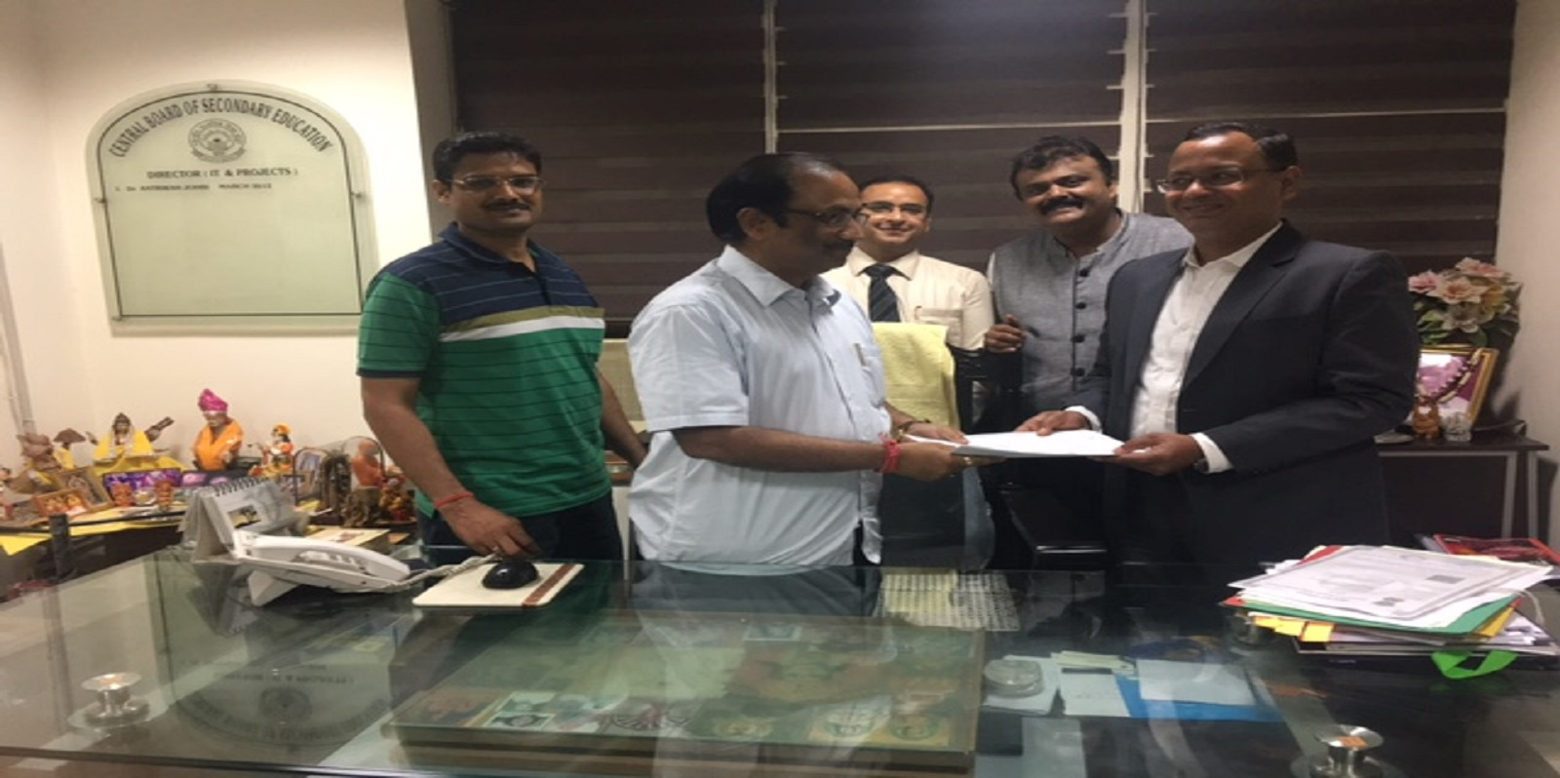
NDML is pleased to welcome CBSE – School Board in NAD

Slide 9
School & Technical Boards
Assam | Assam Higher Secondary Education Council, Guwahati
Delhi | Board Of Technical Education, Delhi Central Board Of Secondary Education, Delhi
Goa | Goa Board Of Secondary And Higher Secondary Education, Goa
Manipur | Board Of Secondary Education, Manipur Council Of Higher Secondary Education Manipur, Imphal
Meghalaya | Meghalaya Board Of School Education, Shillong
Mizoram | Mizoram Board Of School Education, Aizawl
Nagaland | Nagaland Board Of School Education, Kohima
Tripura | Tripura Board Of Secondary Education, Agartala

Slide 10
Region & State Wise List of Participating Academic Institutions
Open the PDF to view the entire list

Slide 11
NAD – Vision
Central, National, Online, Secure platform for
Academic Institutions (AI) to generate , issue and deliver Academic Awards to Students in a digital manner; No need to issue paper certificates
Maintain records in a uniform, secure manner; Completely secure, online, standardized records
All awards of the Students in a single, online NAD account ; Complete Life Cycle of Student’s Academic Progression
Online verification of all awards with the consent of the student
End to the menace of fake & forged certificates
Trusted Credible Certificates, No intermediation, Faster Jobs / Loan processing

Slide 12
Academic Institutions – Champions of Change
Join NAD – Choose Depository, Sign Agreement, Create Nodal Cell
Training & Handholding
Prepare Data for lodgment as per NAD Data Format
Metadata of courses conducted, certificate templates, colleges affiliated, exam schedules
XML Data with student identity
Validated with Data Validation Utility (XSD)
Digital Signatures
Certificate Template prepared by Depository OR digitally signed Certificate Image Files
Data Lodgment with Maker & Checker review
Lodge any award modification / cancellation, View Reports
Update Student Identity against an award (if not seeded initially)
Resolve Grievances (if any)

Slide 13
https://nad.ndml.in https://nad.gov.in
Thank You

